Slide 1


North American Airports & Complex Network
Course Project of Complex Network.
Professors:
Dr. Chen
DR. Hu
Students:
Keyvan derakhshan nik
Huizhong liu

Slide 2

Importance of Airport Network
700 million passenger traveled through 20 busiest airport around the world. (https://www.virgin.com)
North America’s commercial airports are generating billions of dollars in annual activity, and supporting millions of good, stable jobs. (http://aci-na.org)

Slide 3
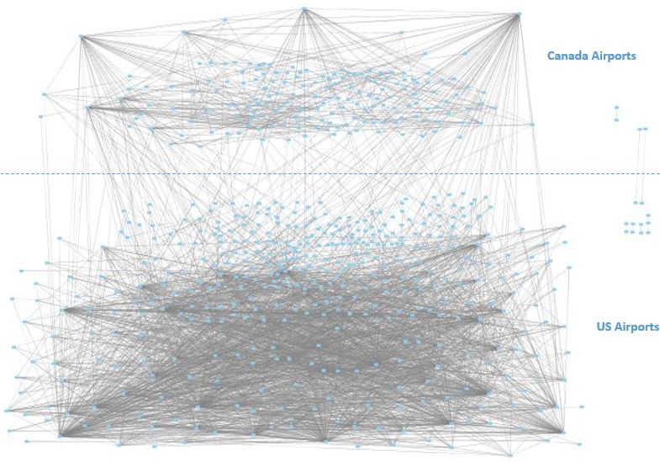
North America Airport Graph

Slide 4
Some Basic Information North America Airport Graph

